Slide 1
Leading Change:The Challenge of WBL
Professor Patrick Flood

Slide 2
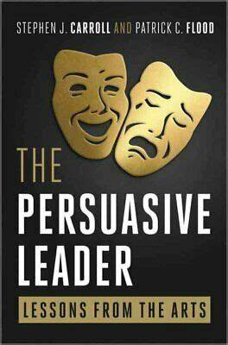
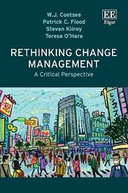
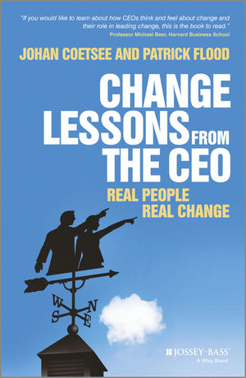


Slide 3
LEADING CHANGE IN EDUCATION
CHANGE READINESS
STRATEGIC
POSITIONING
WINNING HEARTS
AND MINDS
ACHIEVING
BALANCE
LEADERSHIP OF
LEARNING
Strategic reflection, Coaching & Feedback
Designing New
Model in Educations
Forces for Change
How can we persuade?
Educated Person
Work Ready
Am I ready?
What is the context?
Do we have
a vision?
All on board?
What levers
can we pull to
get results?
Curation
Content Creation
Are we ready as a team ?
Creating capacity
Digital
AI Resources
Participation & Communication

Slide 4

CHANGE READINESS
Changing the
Complacent
Mind-set
Feedback & learning
Readiness
for
change
Urgency
Participation & Communication

Slide 5
STRATEGIC POSITIONING
Understanding the context
Knowledge workers
Developing the vision
Alignment of stakeholders

Slide 6
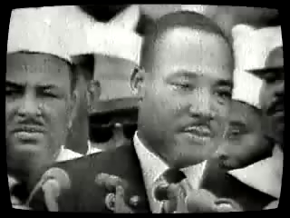
VISION: MARTIN LUTHER KING

Slide 7

WINNING HEARTS AND MINDS
Feedback and learning
Understanding
Implications of
Present Reality
Participation & Communication

Slide 8
WINNING HEARTS AND MINDS
Key logs
The critical 15%
Symbols
Pride

Slide 9
ACHIEVING BALANCE
A new structure?
Who in what position?
Role of Teams?
What levers to pull to get results
Impact on
revenue
and costs?

Slide 10

LEADERSHIP OF LEARNING
Creating Value
Creating Urgency

Slide 11
WBL and Universities
The continuum of WBL
Challenge based learning
Co-operative education
Employers still want critical thinkers
Many see AI proficiency as teachable at work
You visit me and I’ll visit you
WE STILL NEED EDUCATED PEOPLE!

Slide 12
SUMMARY TAKE AWAYS
CHANGE EQUATION
Pressure for
Change;
Leadership
Clear shared
Vision;
Power
Capacity for
change
Actionable
first steps
Successful
Change
Clear shared
Vision;
Power
Capacity for
change
Actionable
first steps
Do this
next week
Pressure for
Change;
Leadership
Capacity for
change
Actionable
first steps
Action that
loses
direction
Pressure for
Change;
Leadership
Clear shared
Vision;
Power
Actionable
first steps
Anxiety /
frustration
Pressure for
Change;
Leadership
Clear shared
Vision;
Power
Capacity for
change
Haphazard
efforts /
false starts
Beckhard, R., & Harris, R. Organizational transitions. Reading, MA: Addison Wesley

