Slide 1



Work-Based Learning Champion
Erasmus+ KA220-HED | Project No: 2024-1-IT02-KA220-HED-000245540
Funded by the European Union. Views and opinions expressed are however those of the author(s) only and do not necessarily reflect those of the European Union or the Erasmus+ National Agency -INDIRE. Neither the European Union nor the granting authority can be held responsible for them.
Project No: 2024-1-IT02-KA220-HED-000245540

Slide 2


THE PROBLEM
Why WBL Matters: The Evidence
Across Malta, Italy, Portugal and Ireland, our national reports reveal the same pattern: WBL is widely valued but consistently under-delivered. Curricula are misaligned with labour market needs, employer engagement is weak, and digital readiness is a critical gap. We can no longer ignore the numbers.
EU Graduate Skills Gap
74%
of EU employers report difficulty finding graduates with the right skills (CEDEFOP, 2023)
WBL in Higher Education
40%
of HEI degree programmes lack structured WBL (OECD Education at a Glance, 2023)

Slide 3
WBL DEFINED
What is Work-Based Learning?
Real-World Application
Assessed Learning
WBL activities are tied to specific learning outcomes and formally assessed — not just work experience.
An educational strategy integrating academic learning with authentic workplace experiences, linking theory to practice.
Employer Partnership
Structured Outcomes
Students work with real employers on real tasks, developing industry-relevant competencies.
Activities are planned, monitored and reflective — from pre-WBL planning through to post-activity assessment.

Slide 4


ERASMUS+ KA220-HED
Introducing wblchampion
WBL Champion is a 2-year Erasmus+ Cooperation Partnership (2024-2026) uniting four organisations across Malta, Italy, Portugal and Ireland. Our mission: equip Higher Education Institutions with the tools, training and frameworks to embed Work-Based Learning at scale. We are building free, open resources so any institution across Europe can implement WBL with confidence.
Coordinator: VITECO SRL (Italy) | Partners: INOVA+ (Portugal), Knights College (Malta), TU Dublin (Ireland) |
Co-funded by the European Union

Slide 5
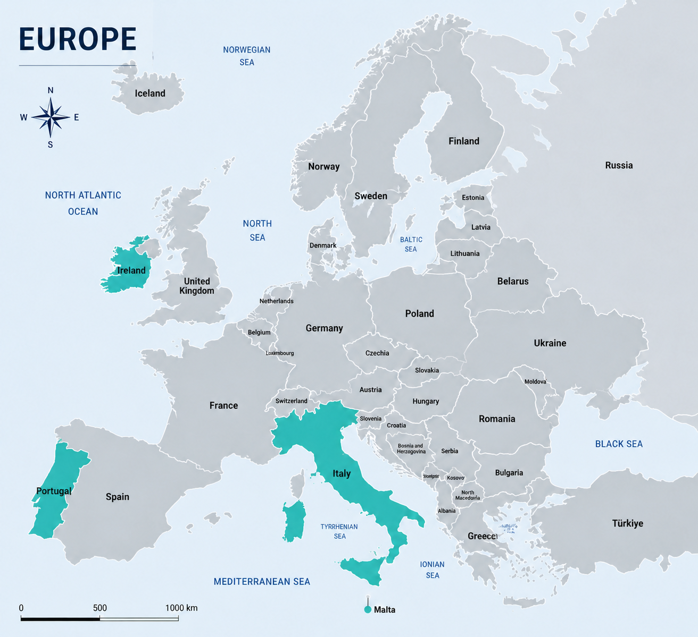




CONSORTIUM PARTNERS

Slide 6

WHAT WE BUILT
Key Outputs: Research & Courses
① National WBL Reports: Desk research across Malta, Italy, Portugal and Ireland — benchmarking WBL policy and practice. Published in all four languages plus a comparative EU-wide synthesis report.
② 6 WBL-Embedded HE Courses: 3 from Knights College, 3 from TU Dublin. Existing curricula redesigned from the inside out to embed assessed WBL — not as add-ons, but as core methodology.
③ QA Toolkit: Quality standards and assessment guidelines for WBL programmes, developed by INOVA+ and applicable beyond the consortium.

Slide 7
5
Open Resources
OPEN ACCESS
Key Outputs: CPD & Online Platform
3 CPD Courses for HE educators (Academic Coordinator, Academic Supervisor, industry Mentor).
The Online Platform by VITECO houses all outputs: CPD courses, QA toolkit, national reports.
Free, open access for any institution. Built to spread beyond the four consortium partners.

Slide 8
CPD | In piloting
NATIONAL REPORTS | Finalised and published
REDESIGNED PROGRAMMES | Identified and re-designed
QA TOOLKIT | Finalised and published
ONLINE LEARNING PLATFORM | Launching soon
WHERE WE STAND

Slide 9
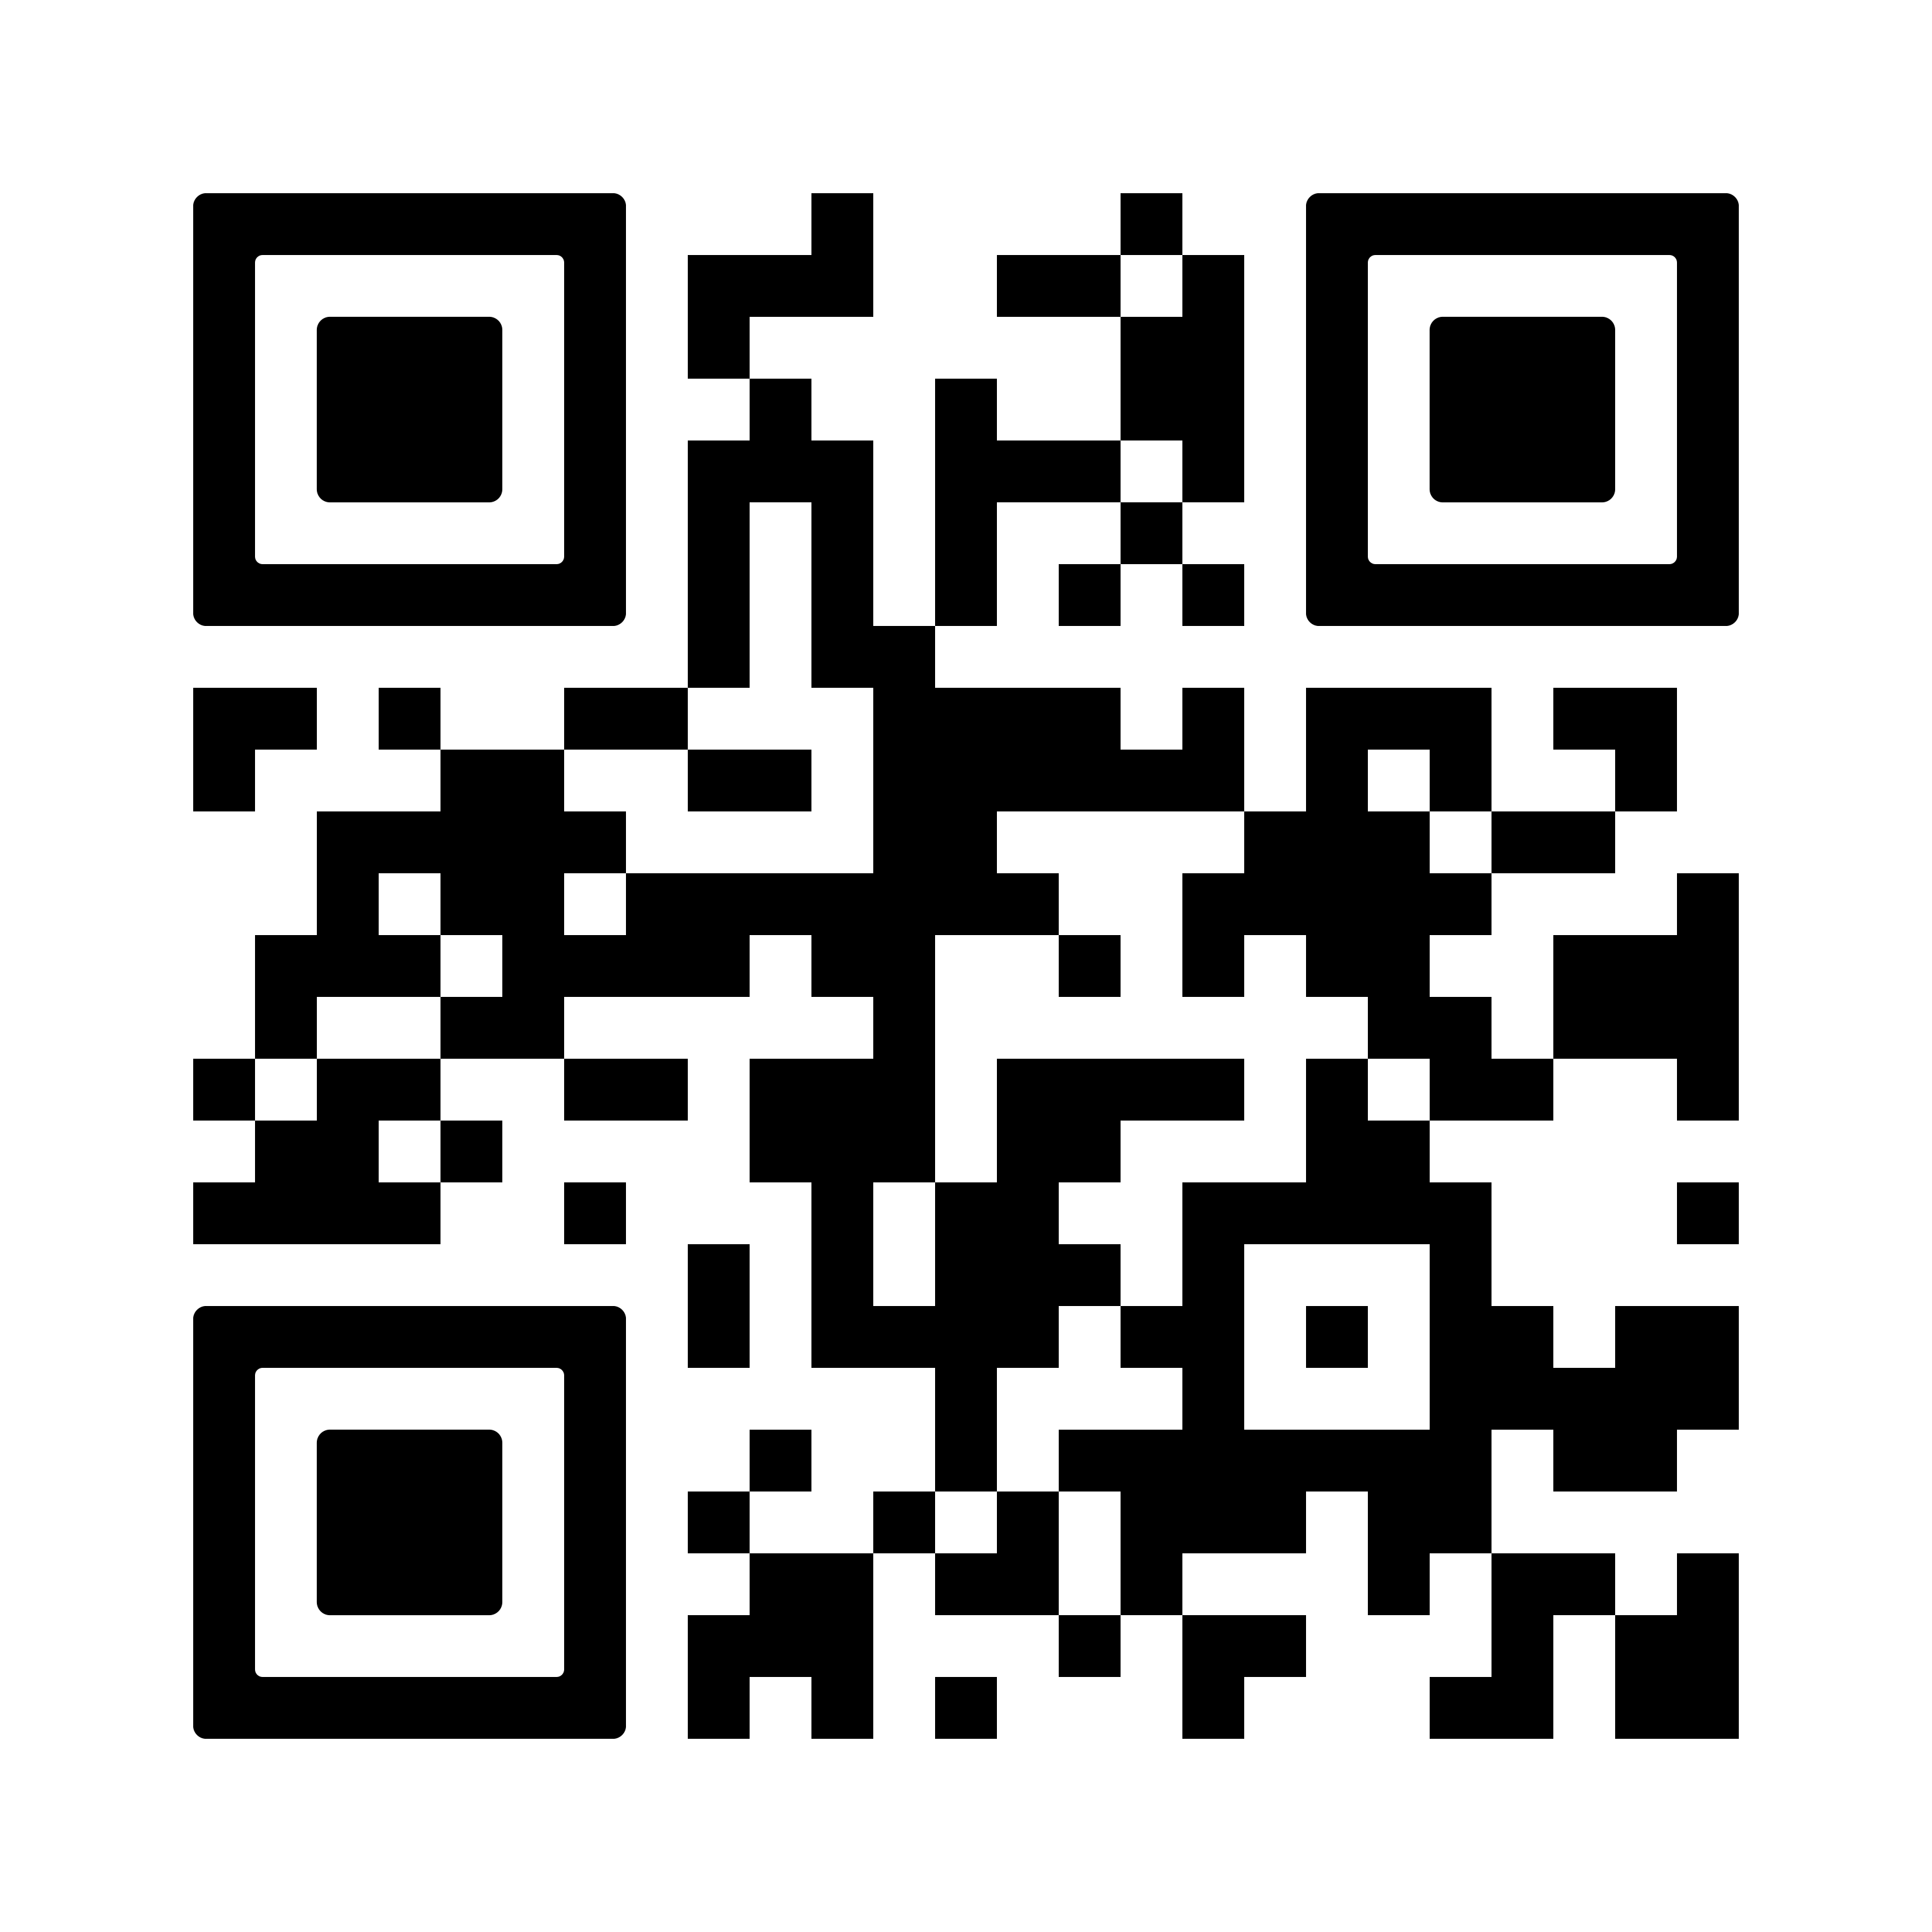
THANK YOU!

